Slide 1
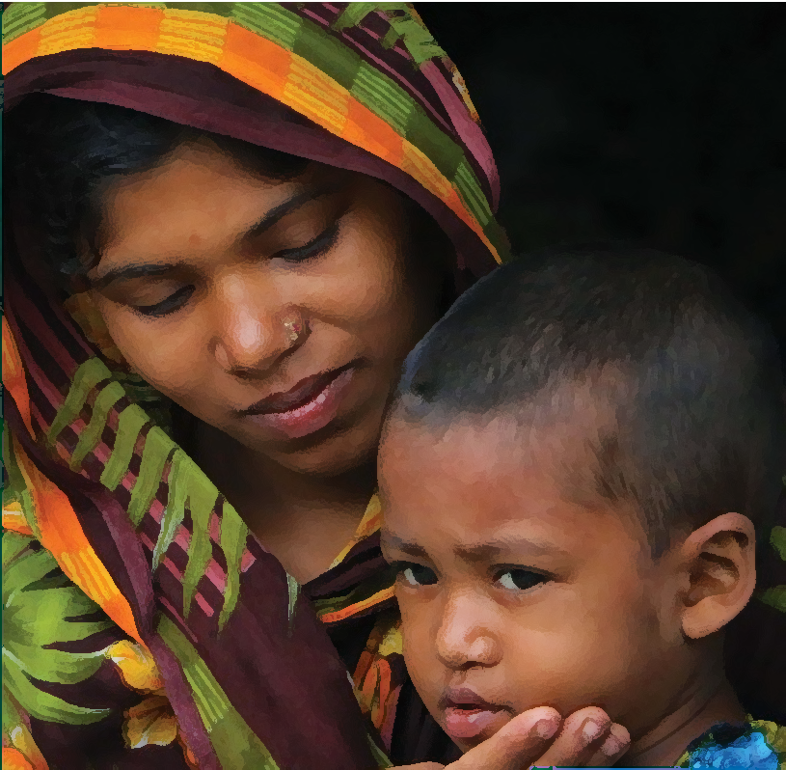
“God could not be everywhere, and therefore he made mothers.” – Rudyard Kipling
Picture Source: United Nations

Slide 2

Maternal Health Risk Prediction
Aparna Raghavendra Rao

Slide 3

Introduction

Slide 4
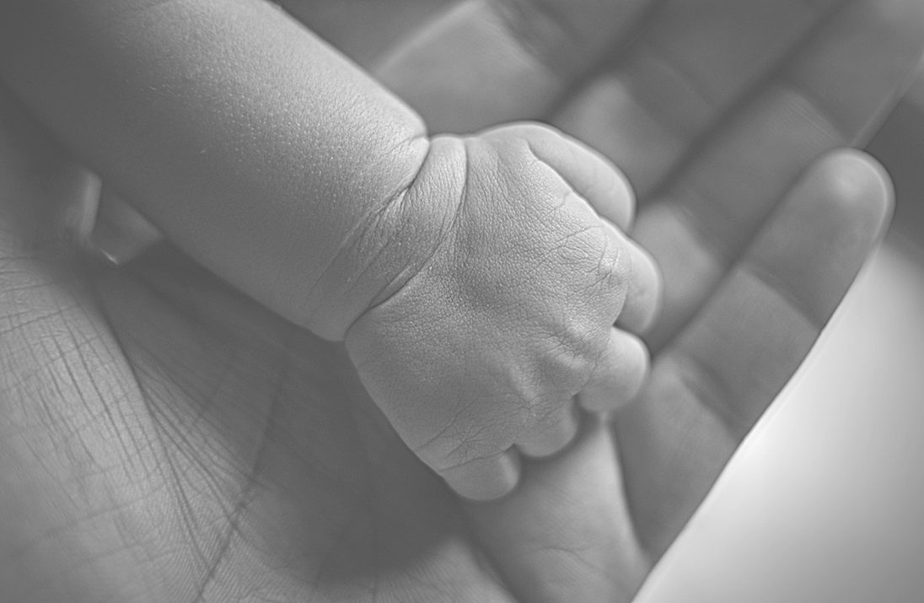
The Problem Statement
Why is this project important?
Maternal Mortality in Bangladesh (2020) – 123 per every 100,000 live births *
Maternal Mortality Rates in the USA –
861 deaths in 2020, 1205 deaths in 2021**
Final Output
Code that collects user input and predicts the health risk level for expectant mothers.
Sources –
* EveryMotherCounts. (n.d.). Bangladesh: A Deeper Dive. Every Mother Counts. Retrieved February 25, 2024, from https://everymothercounts.org/grants/bangladesh-a-deeper-dive/
** Hoyert, D. L. (2023, March 16). Maternal Mortality Rates in the United States, 2021. Centers for Disease Control and Prevention. Retrieved February 26, 2024, from https://www.cdc.gov/nchs/data/hestat/maternal-mortality/2021/maternal-mortality-rates-2021.htm

Slide 5
The End User
This project aims at benefiting healthcare providers in rural areas of Bangladesh
What are the benefits?
Code: The code is simple and aimed towards non-technical stakeholders
Environment: RStudio is open-source and cost-effective
End Product: The end-product is user-friendly and interactive. The code predicts the patient’s risk category and additional warnings (deviation from considered normal)

Slide 6
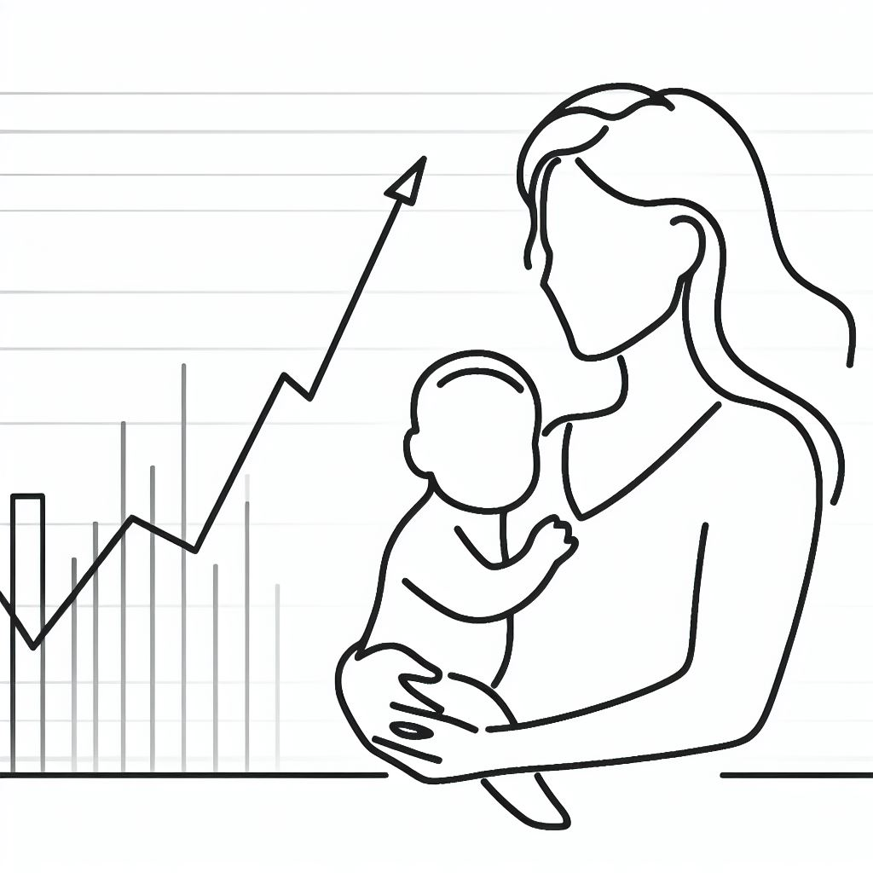
Data & Exploratory Data Analysis

Slide 7
The Data
Dataset used: Maternal Health Risk Dataset from the UC Irvine Machine Learning Repository
About the data: 1014 records and 7 features
Data Description
Feature Variables:
Age – Integer, Systolic BP (in mmHg) – Integer, Diastolic BP (in mmHg) – Integer, Blood Sugar (in mmol/L) – Numeric, Body Temperature (in Fahrenheit) – Numeric, Heart Rate (in Beats Per Minute) – Integer
Target Variable:
Risk Level – Categorical – high risk, mid risk and low risk
Environment: RStudio
Packages and Libraries:
Multinomial Regression – caret, nnet package
Decision Trees – DAAG, party, rpart, mlbench, pROC, tree
K-Nearest Neighbors – class, e1071, FNN, gmodels, psych
Visualization – ggplot2, gridExtra, RColorBrewer

Slide 8
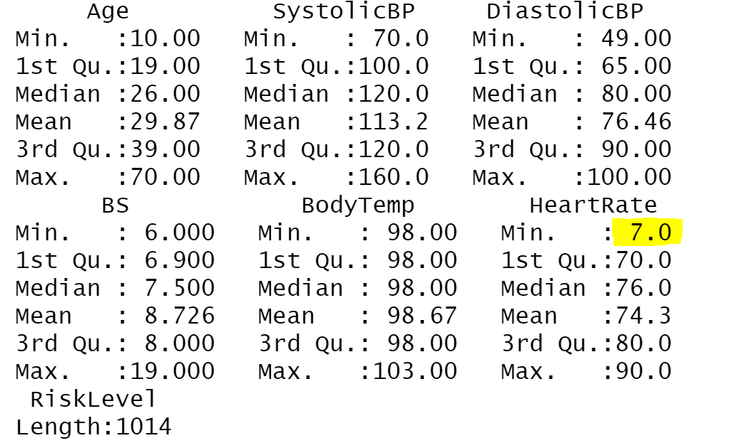
Exploratory Data Analysis
The EDA revealed an error in the data – two entries where heart rate was recorded as 7 (human heart beats between 60-90 bpm). Those entries were dropped from the data.
There are no null values in the data

Slide 9
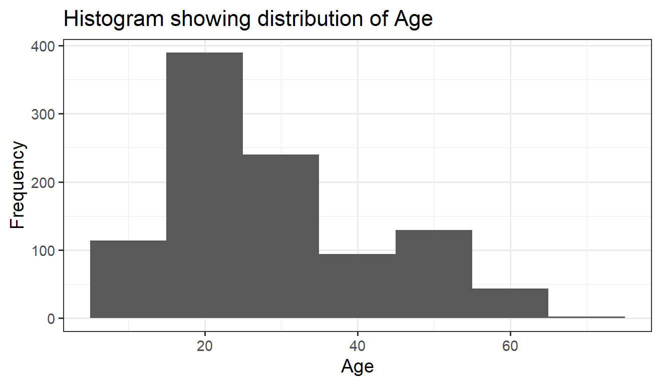
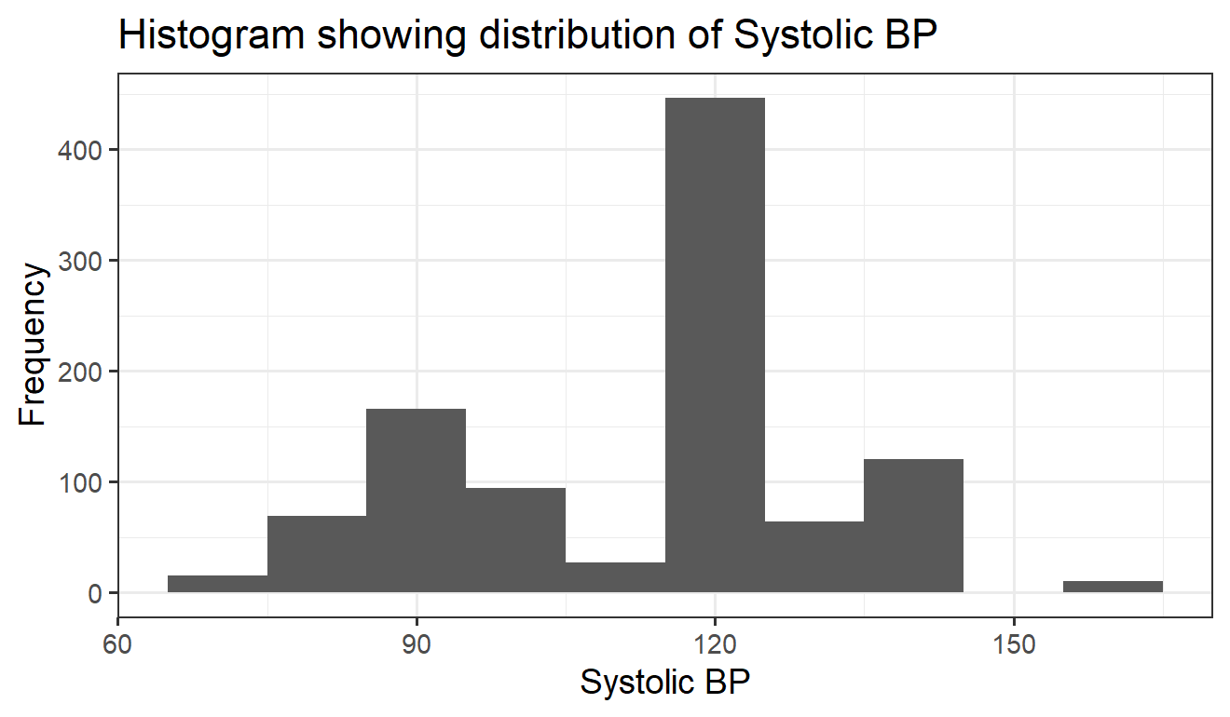
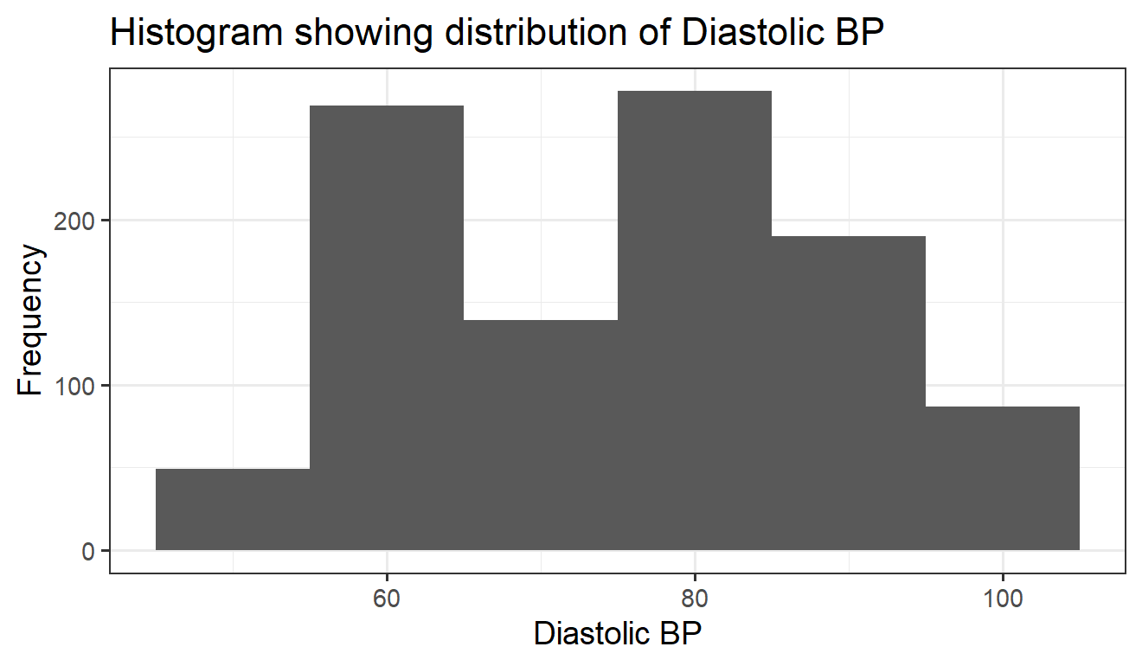
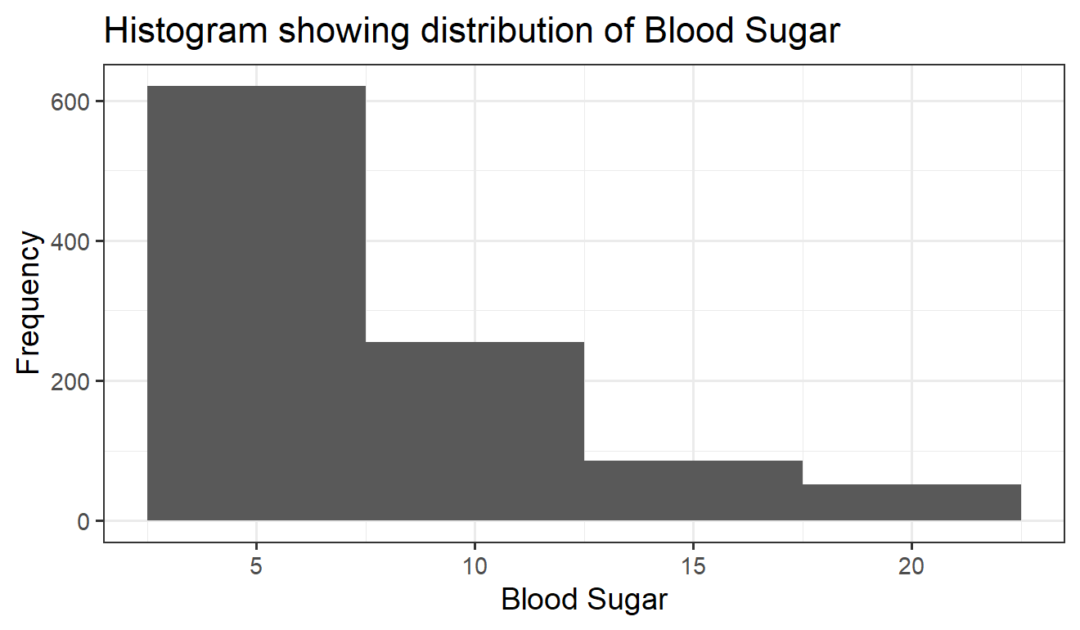
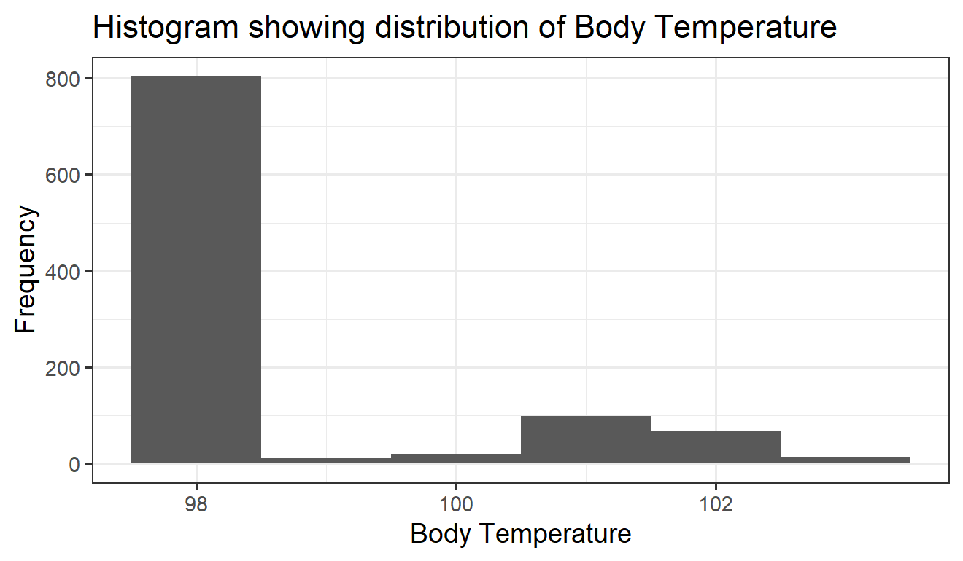
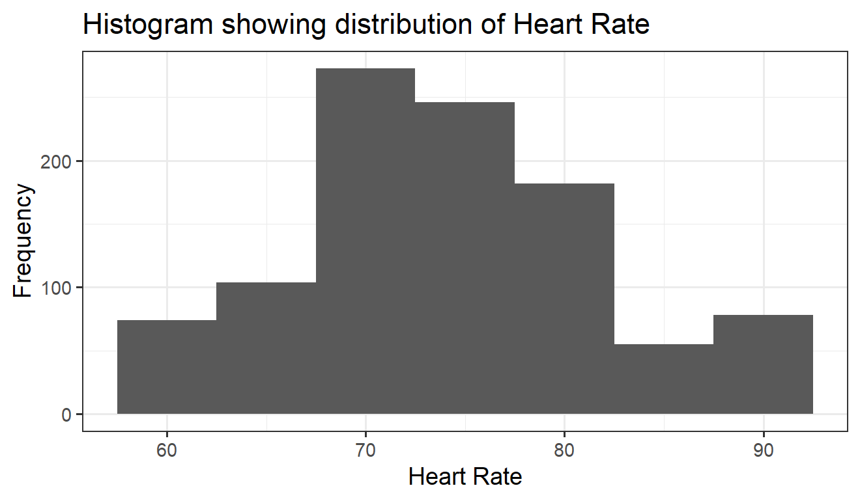
Blood sugar deviates the most from the normal range for pregnant women

Slide 10
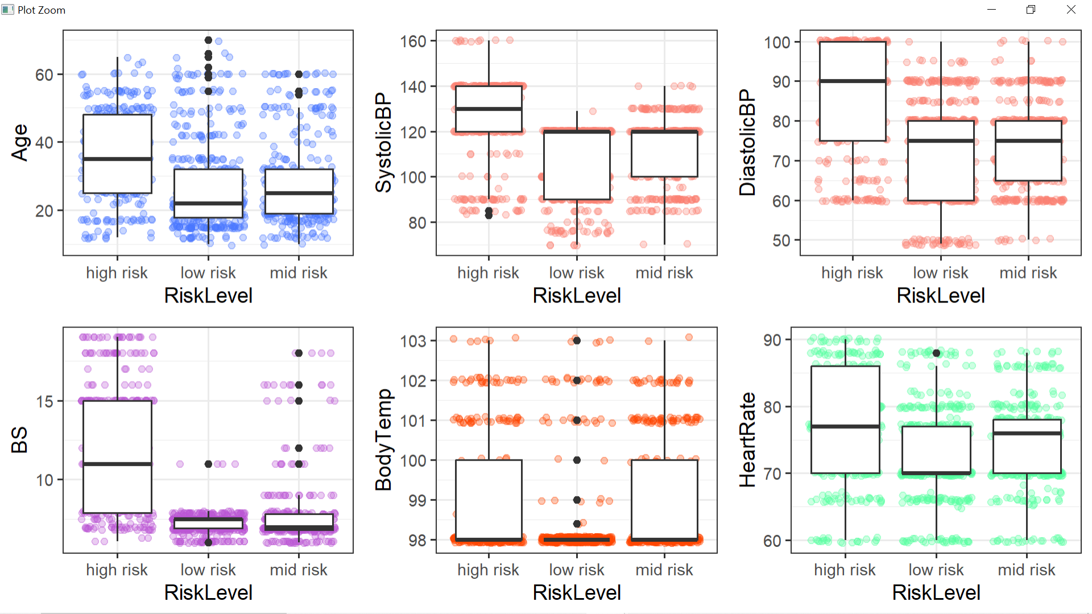
A higher age or running a temperature does not always mean a higher risk

Slide 11
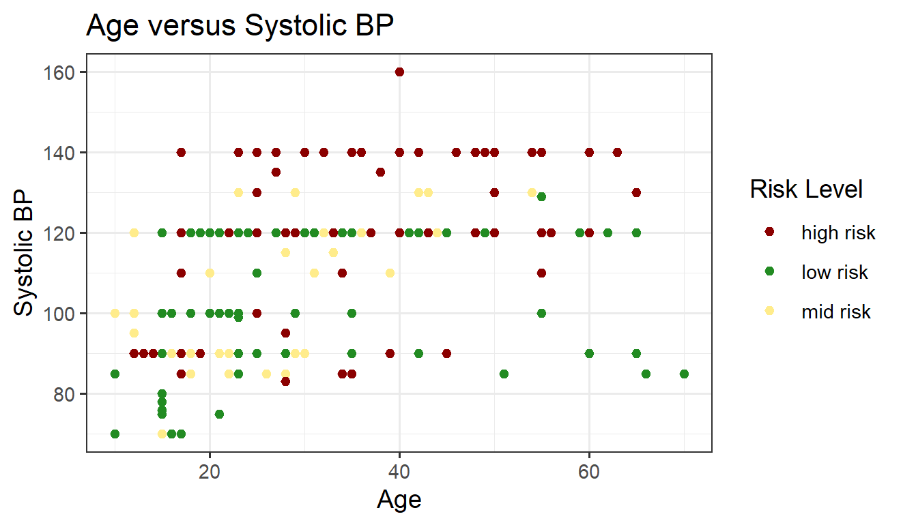
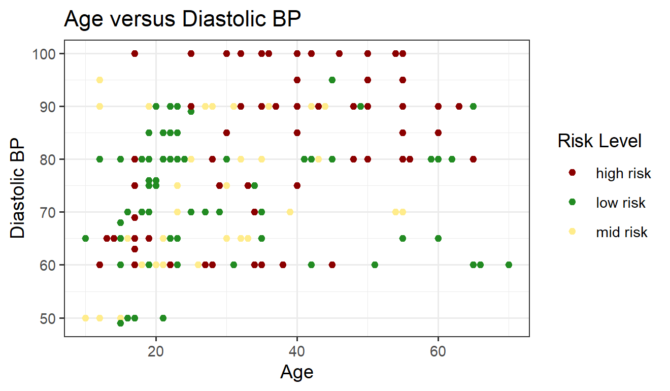
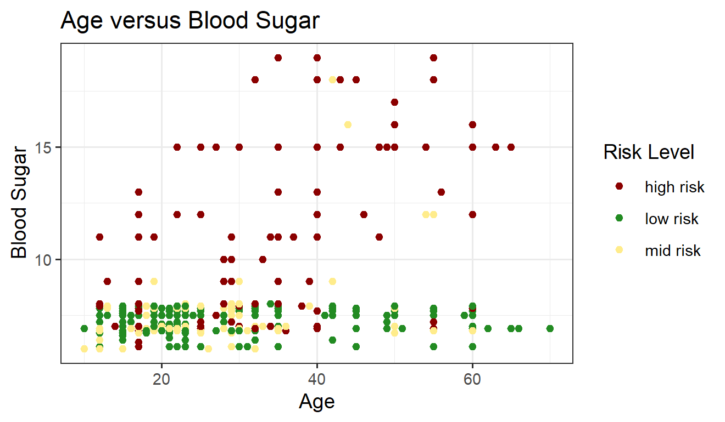
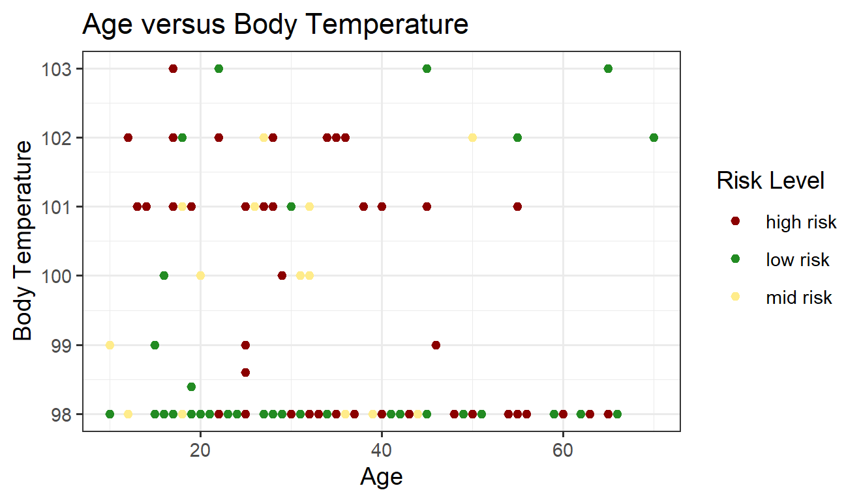
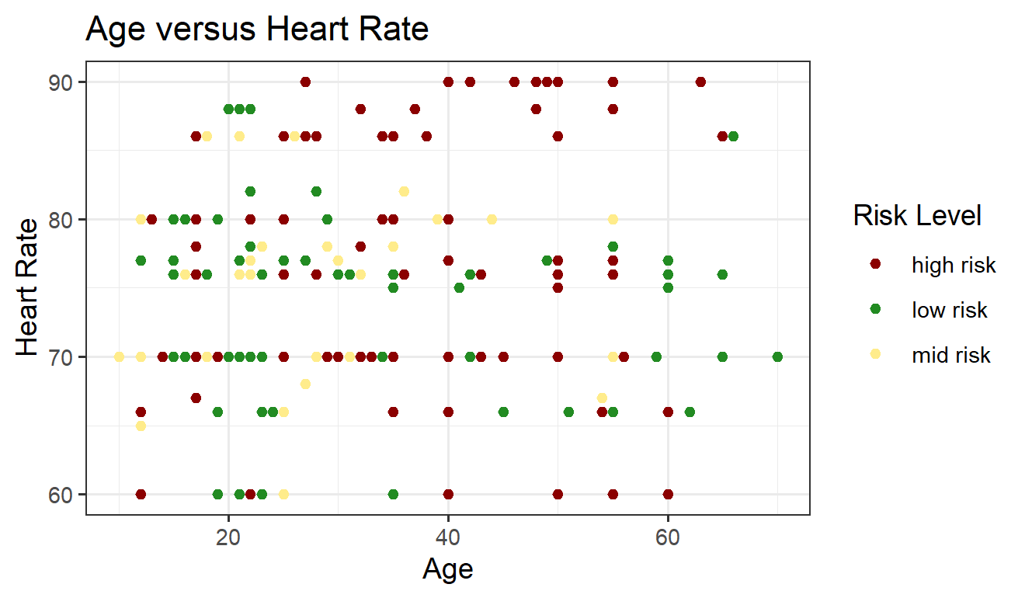
Age + Body Temperature & Age + Heart Rate do not impact the risk level of the patient

Slide 12

Data Modeling

Slide 13
Multinomial Regression
Supervised
Logistic Regression is used for binary classification, whereas multinomial regression can be used for multiclassification.
Preprocessing required:
Set seed
Convert categorical target variable to factor type [as.factor()]
Split into train and test (80%-20%)
Model was evaluated using a classification matrix
Training accuracy: 62.76%
Test accuracy: 60.20%

Slide 14
Decision Tree
Supervised
Can be utilized for both classification and regression problems.
Preprocessing required:
Set seed
Split into train and test (80%-20%)
Model was evaluated using the confusion matrix
Training accuracy: 70.38%
Test accuracy: 66.98%

Slide 15
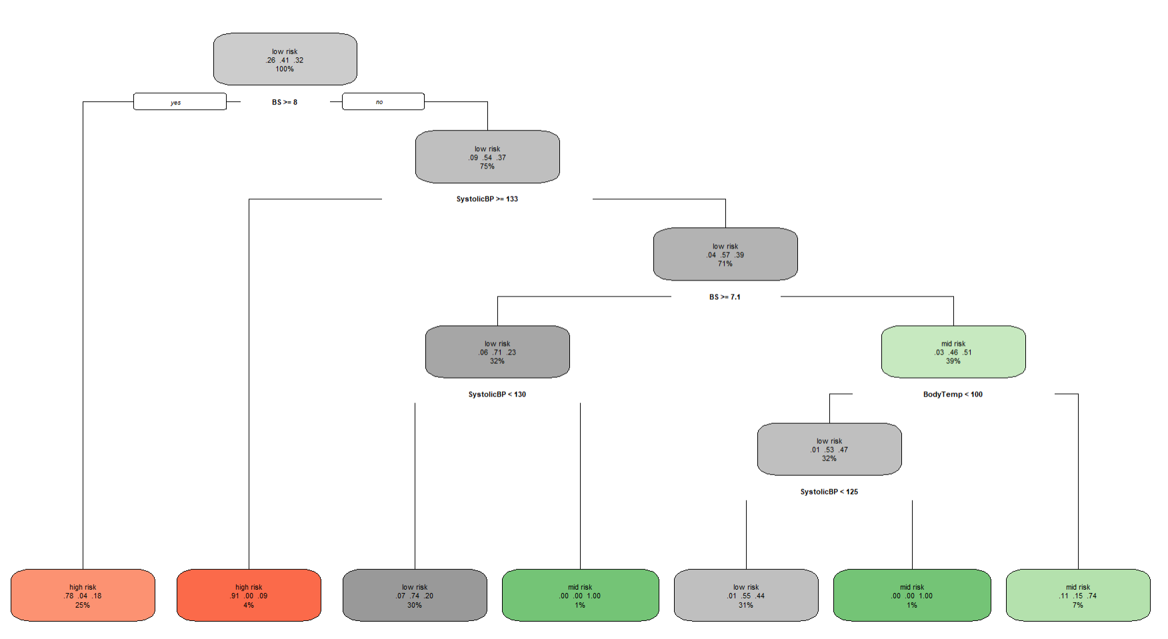
The first binary split in the tree is made based on blood sugar

Slide 16
K-Nearest Neighbors
Supervised
Uses a distance metric to classify data points.
Preprocessing required:
Change variable names to lowercase
Split the feature variables and target variables
Dummy coding (was not required for our data)
Convert the categorical target variable to factor type [as.factor()]
Convert numeric variables to integer type
Set seed
Split into train and test (80%-20%)
Optimal k = 5
The test accuracy of the model was 72.41%

Slide 17
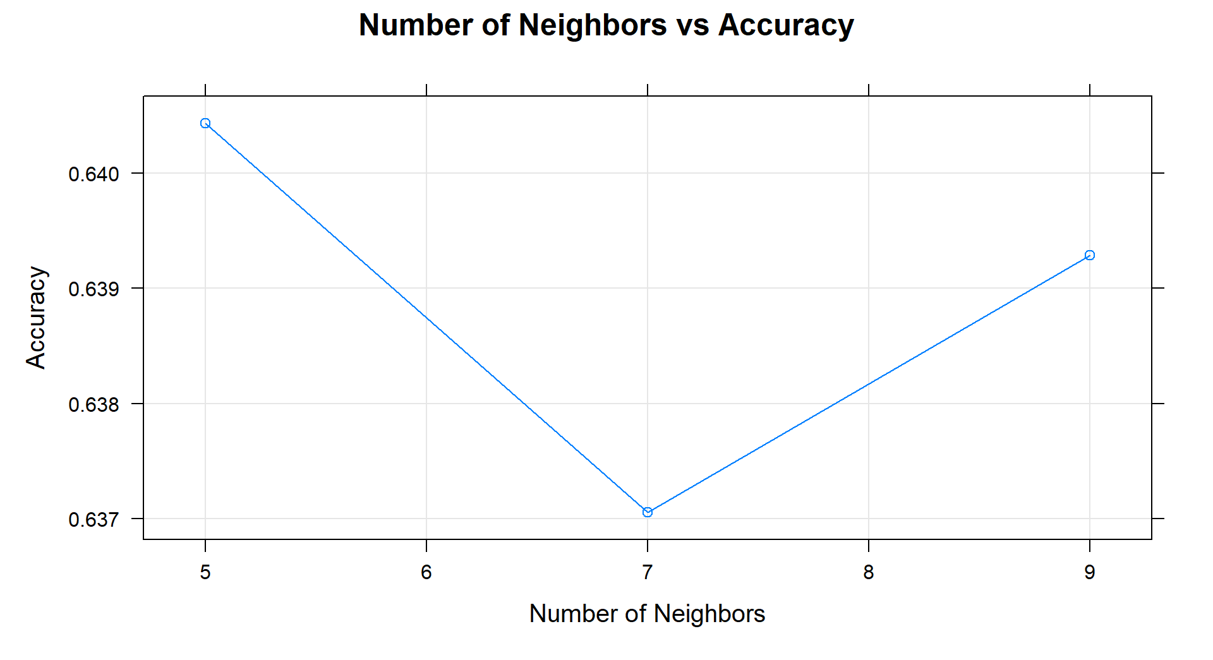
Accuracy is the highest at k=5

Slide 18

Predicting Health Risk Category

Slide 19
Application
A function has been used for the whole calculation
The application –
Prints instructions for the notice of the user.
Collects input from the user on whether they want to proceed.
If yes, collects input on the various parameters such as Age, Systolic BP, Diastolic BP, etc.
Converts it to data frame and predicts the risk category of the patient using the regression model and decision tree model.
Does the preprocessing necessary for KNN (variable names in lowercase, convert to integer).
Predicts the risk category using KNN.
Provides additional warning message if the parameter entered by user deviates from the considered normal.

Slide 20
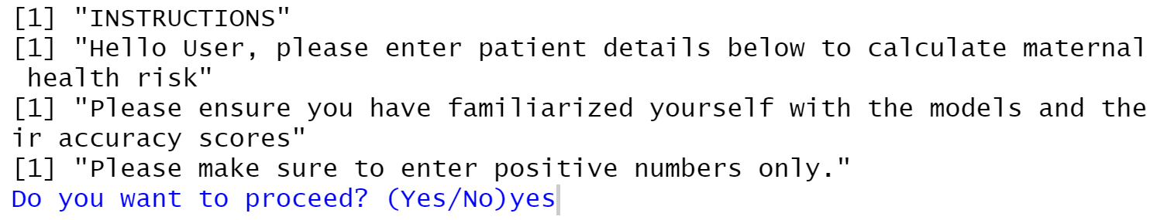
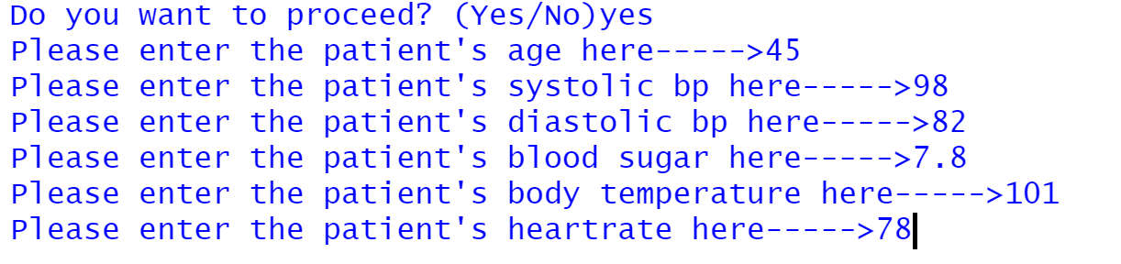
Let us look at an example
Let us feed the application some inputs. Among the inputs, let us include Systolic BP = 98 (low BP) and Body Temperature = 101 (fever).

Slide 21
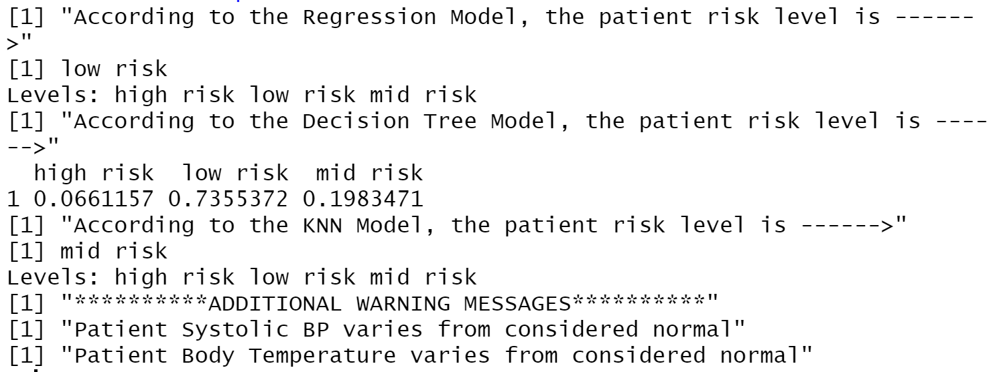
Results
Both Regression and Decision Tree Models place the patient under the low-risk category. KNN classifies the patient as mid-risk. The model has also printed out warning messages that the Systolic BP & Body Temperature vary from normal.

Slide 22
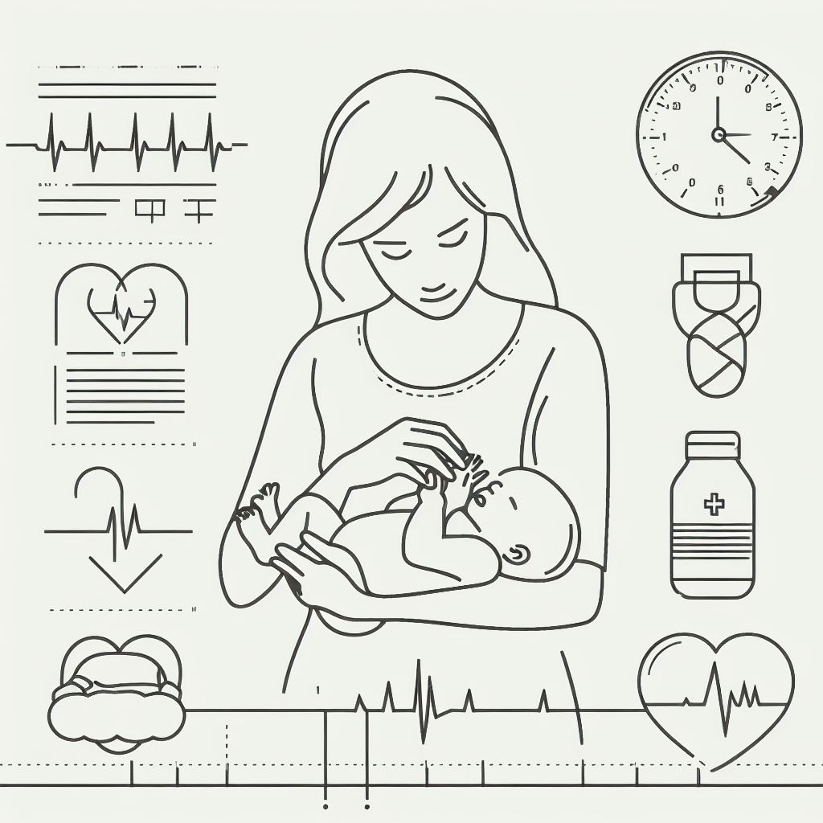
Limitations and Future Scope

Slide 23
Limitations and Future Scope
Limitations:
Small size of the dataset – could lead to bias
Usage of model has a learning curve
Application displays results for all 3 models – may be conflicting in some cases
Future scope:
Include external data sets
Include detailed explanation of concepts in the code
Enhance code to display results only of the model with the highest accuracy

Slide 24
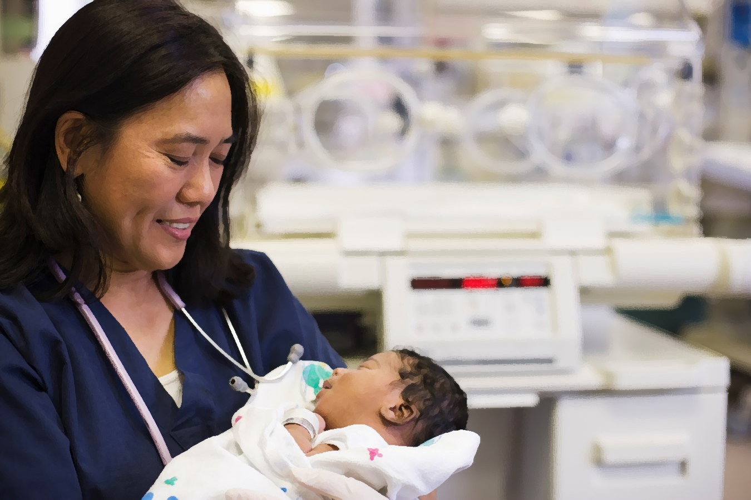
Thank you!

